Slide 1


Amazon Sales Dataset
Data Visualizations on the Cables and Smart TVs available in Amazon’s website
Stuti Poudel
Bootcamp: UNC-VIRT-DATA-PT-09-2023-U-LOLC-MWTH
Project 3
Date:- 2/5/2024

Slide 2
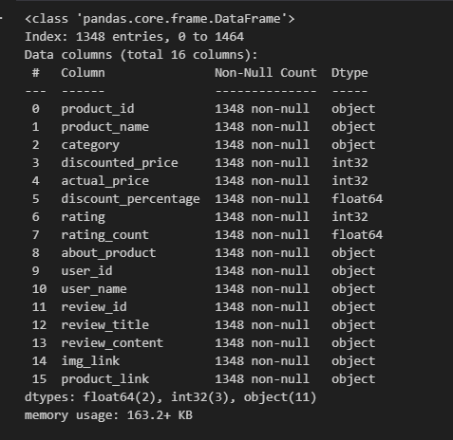
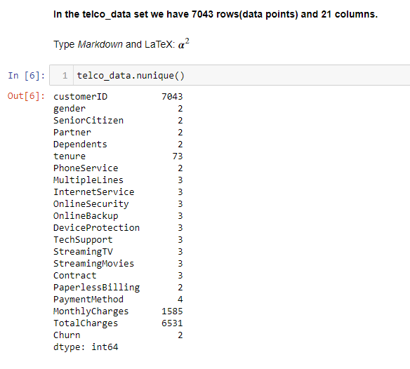

Data exploration
Dataset Overview
Project Overview
There are two types of products for my analysis: 1. USB cables consist of 8 different types. 2. Smart Televisions.
The link for my dataset is as follows: https://www.kaggle.com/datasets/karkavelrajaj/amazon-sales-dataset

Slide 3


Data Cleaning
Data exploration
‘Initial Data Analysis of Amazon data through Python.ipynb

Slide 4

Database Setup
chart 3.
mongoimport --type csv -d Clean_Data_Resources -c amazon_cleanData --headerline --drop amazon_cleanData.csv

Slide 5

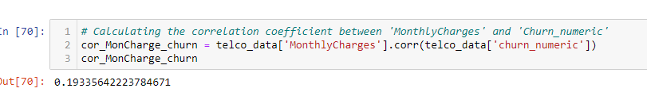
Queries
Functions used
query = {'category': 'ComputersAccessoriesAccessoriesPeripheralsCablesAccessoriesCablesUSBCables',
'rating_count': {'$gte': 50000, '$lte':180000}, 'rating':{'$gte':4}}
# Display the fields
fields = {'category' :1, 'product_id':1, 'product_name': 1 , 'discounted_price': 1, 'discount_percentage':1,'actual_price': 1, "rating":1,"review_title":1, "review_content":1, "rating_count":1}
# sort in descending order by
sort = [('rating_count', - 1)]
# limit the results to the first 5
limit = 5
# Execute the query
result2= (list(amazon.find(query, fields).sort(sort).limit(limit)))
New Python library used: TextBlob.
fig 5.

Slide 6
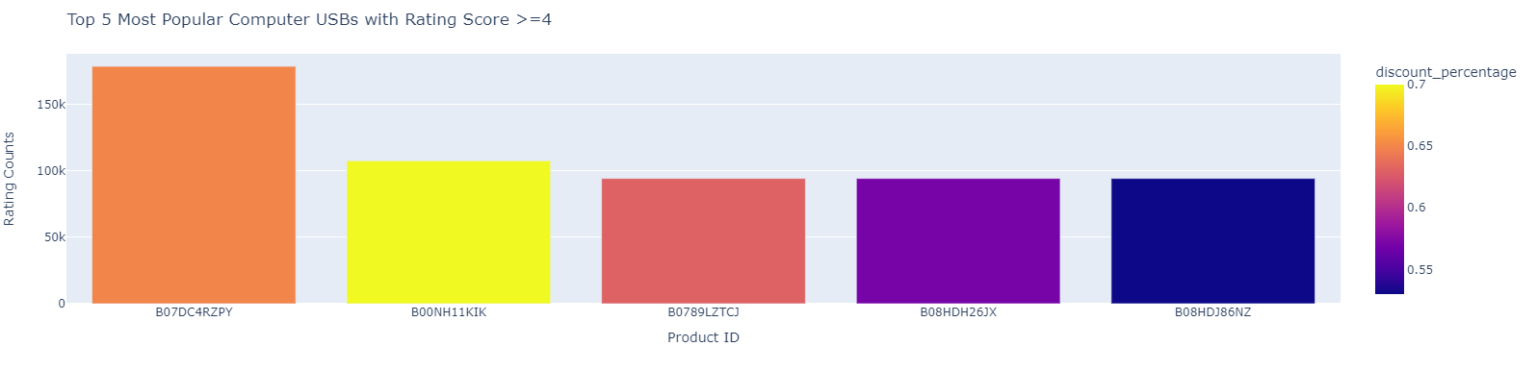
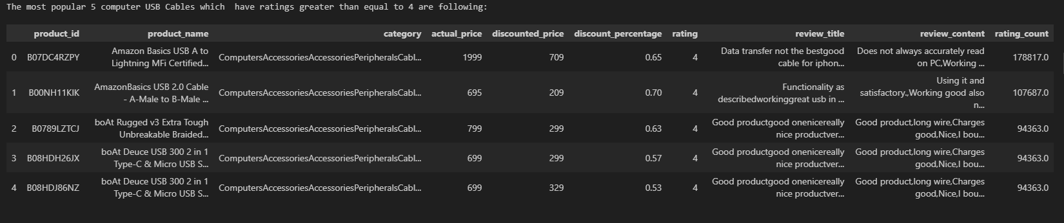
Data Visualizations
Fig. 1 Top 5 Most Popular Computer USBs with rating score >= 4
fig 4.

Slide 7
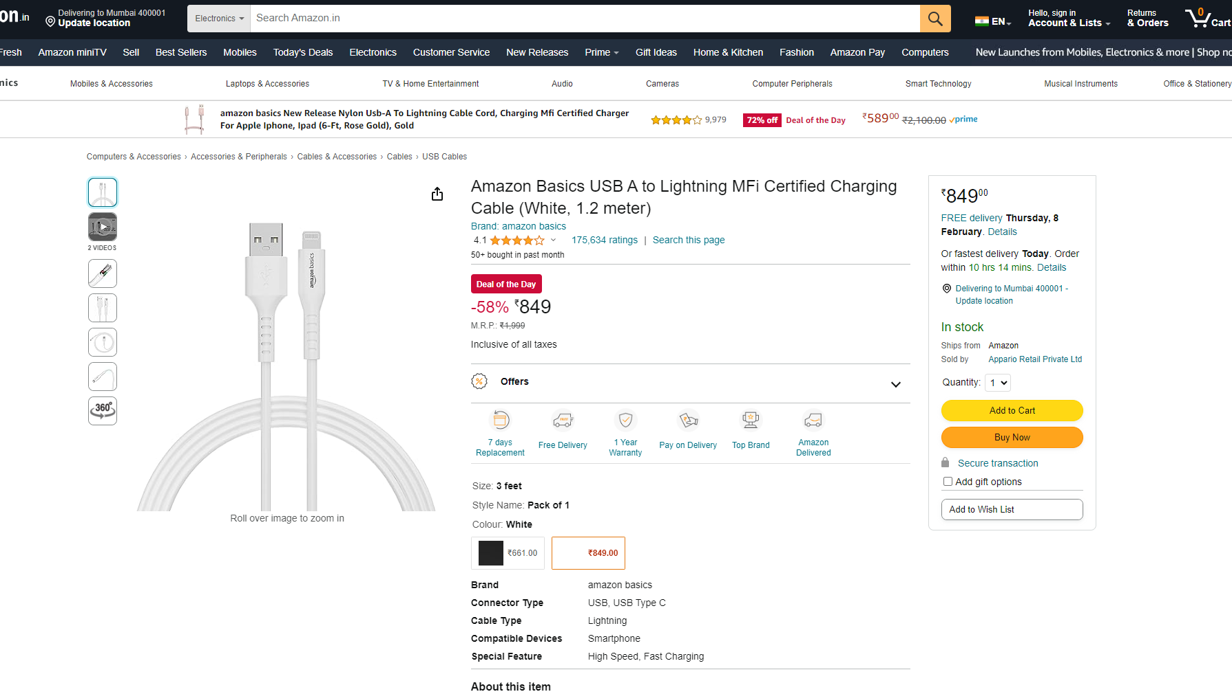
Observations
Computer USB Cables:
- My Amazon dataset has a total of 159 computer USB cables.
- {"Product_id": B07DC4RZPY, "Product_name": Amazon Basics USB A to Lightning MFi Certified...} is the most popular computer USB cable with 1,78,817 rating counts, with a rating score >= 4, in our Amazon dataset.
- I used sentiment analysis on the "review"_content" column of top 5 computer USB products' and found the overall positive reviews, as indicated by the positive polarity scores. Likewise, the reviews appear to contain a mix of subjective opinions and objective statements, with subjectivity scores in the moderate range.

Slide 8
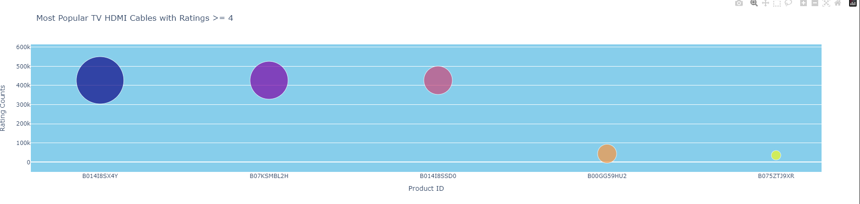
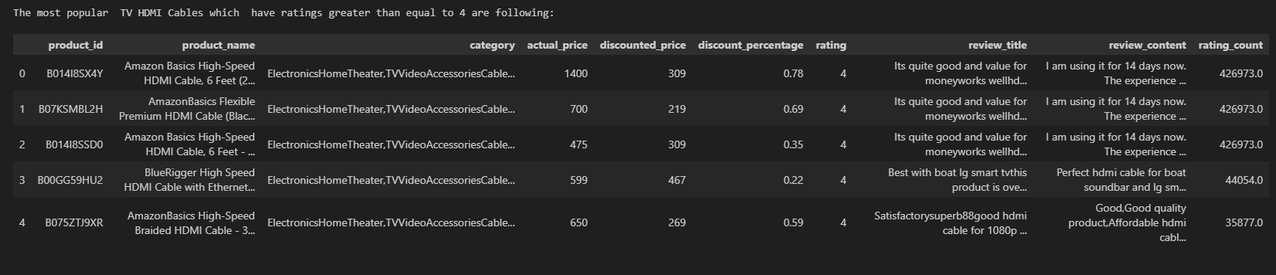
Data Visualizations
Fig2. 5 Most Popular TV HDMIs
fig 5.

Slide 9
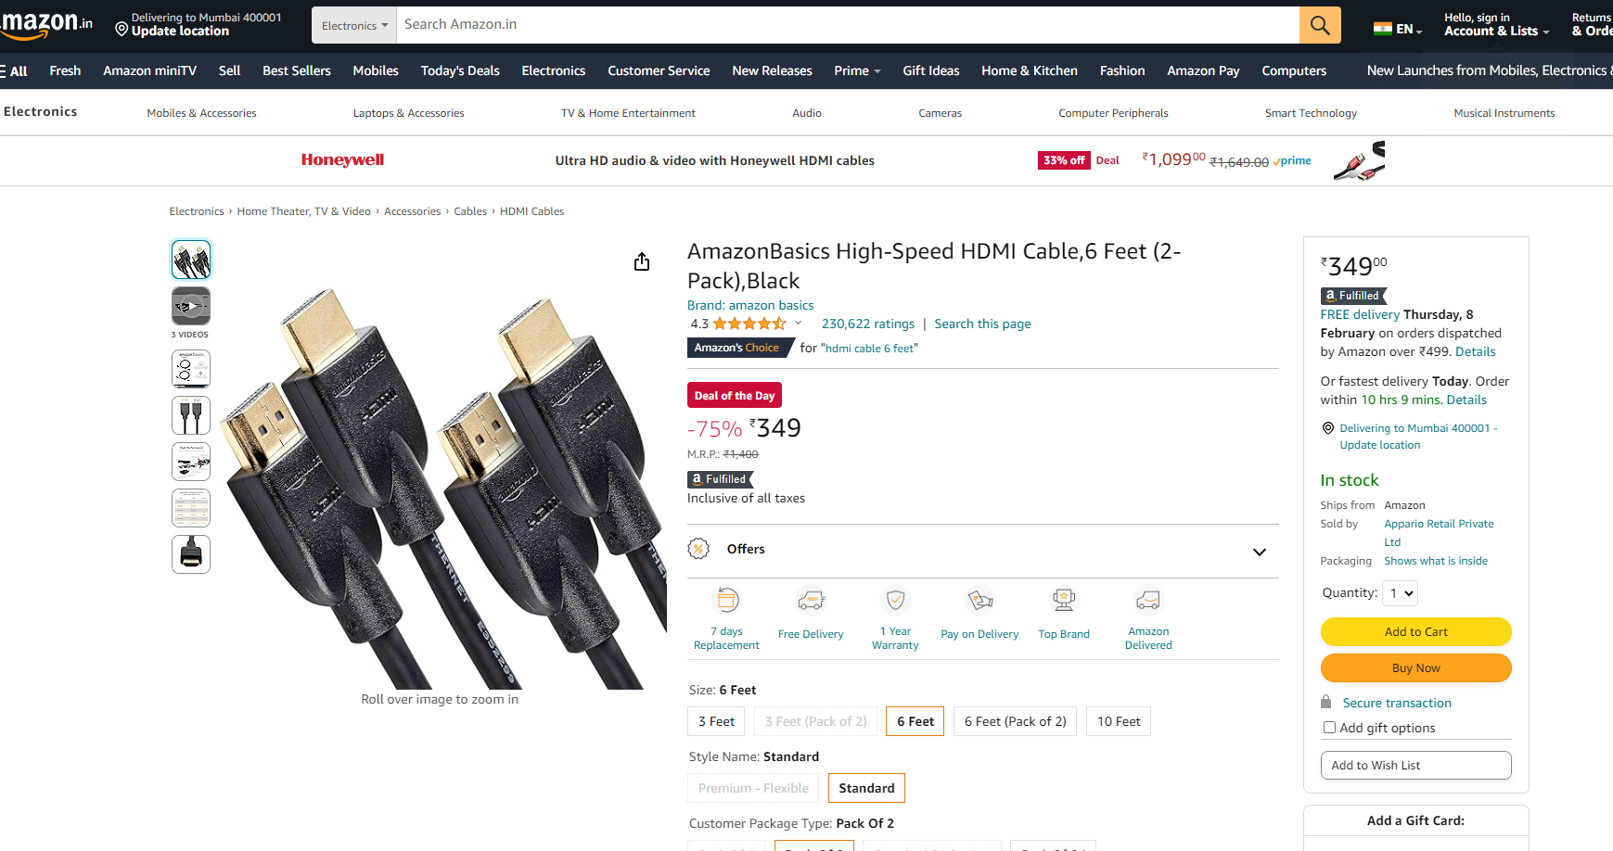
Observations
TV HDMIs Cables
The total number of items that are TV HDMI cables in the result is 21.
- **{"product_id" : B014I8SX4Y, "product_name": Amazon Basics High-Speed HDMI Cable, 6 Feet. }** is the most popular TV HDMI in the dataset, with rating counts of 4,26,973. Likewise, overall, the sentiment analysis of the most popular TV HDMI cables suggests that the reviews given by its customers are generally optimistic about the HDMI cables, with varying degrees of positivity and subjectivity.

Slide 10
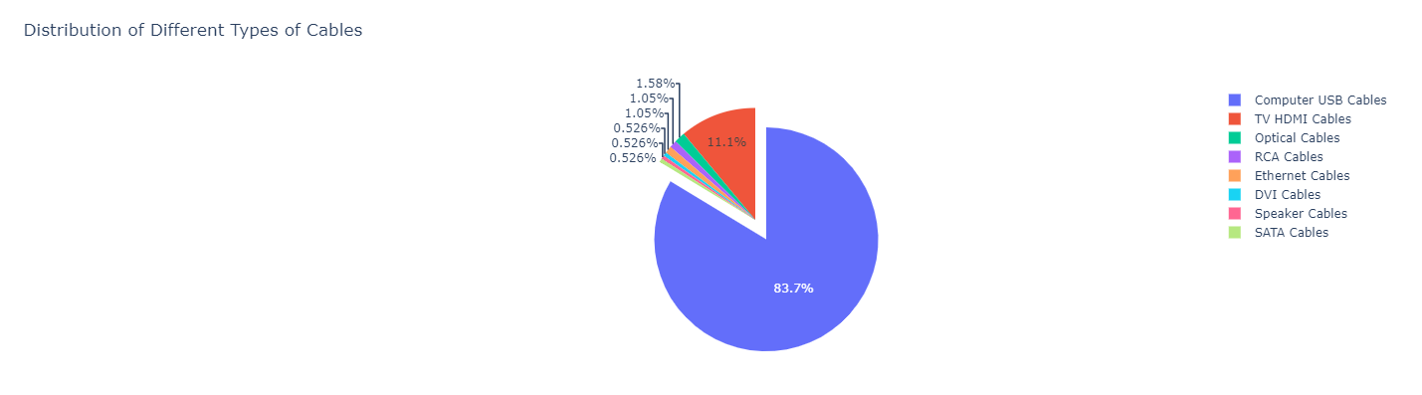
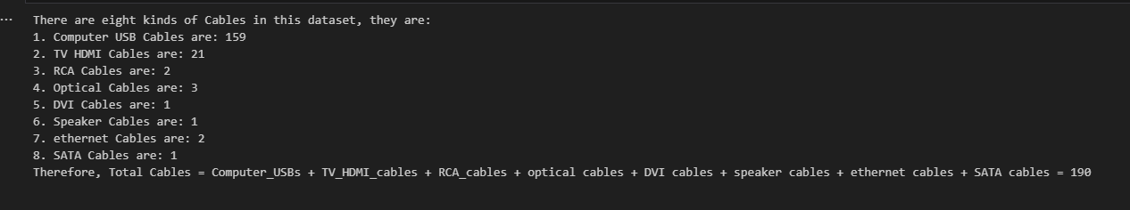
Data Visualizations
Fig3. Different Types of Cables Available
fig 5.

Slide 11
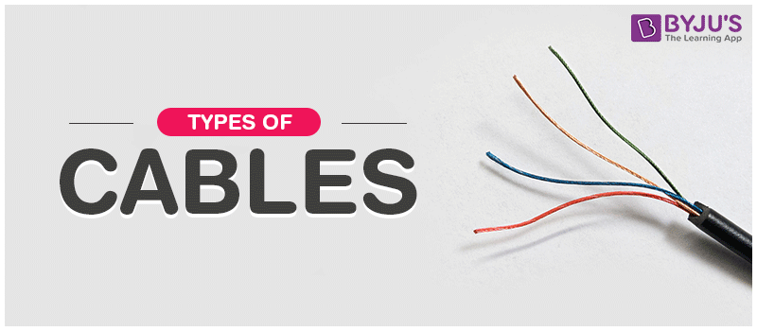
Observations
- Altogether, there are eight kinds of Cables in this dataset, they are:
1. Computer USB Cables are: 159
2. TV HDMI Cables are: 21
3. RCA Cables are: 2
4. Optical Cables are: 3
5. DVI Cables are: 1
6. Speaker Cables are: 1
7. ethernet Cables are: 2
8. SATA Cables are: 1
- Therefore, Total Cables = Computer_USBs + TV_HDMI_cables + RCA_cables + optical cables + DVI cables + speaker cables + ethernet cables + SATA cables = 190.

Slide 12
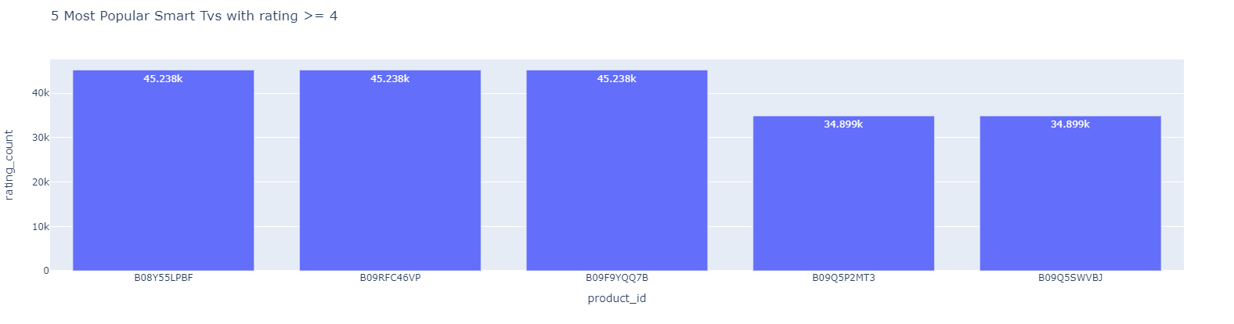
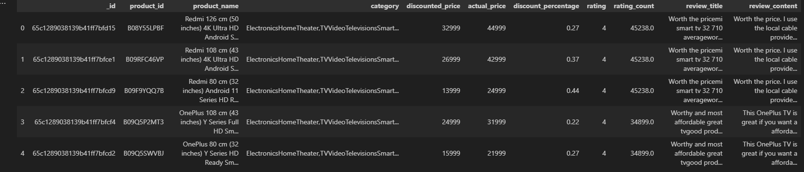
Data Visualizations
Fig 4. 5 Most Popular Smart Tvs
fig 5.

Slide 13
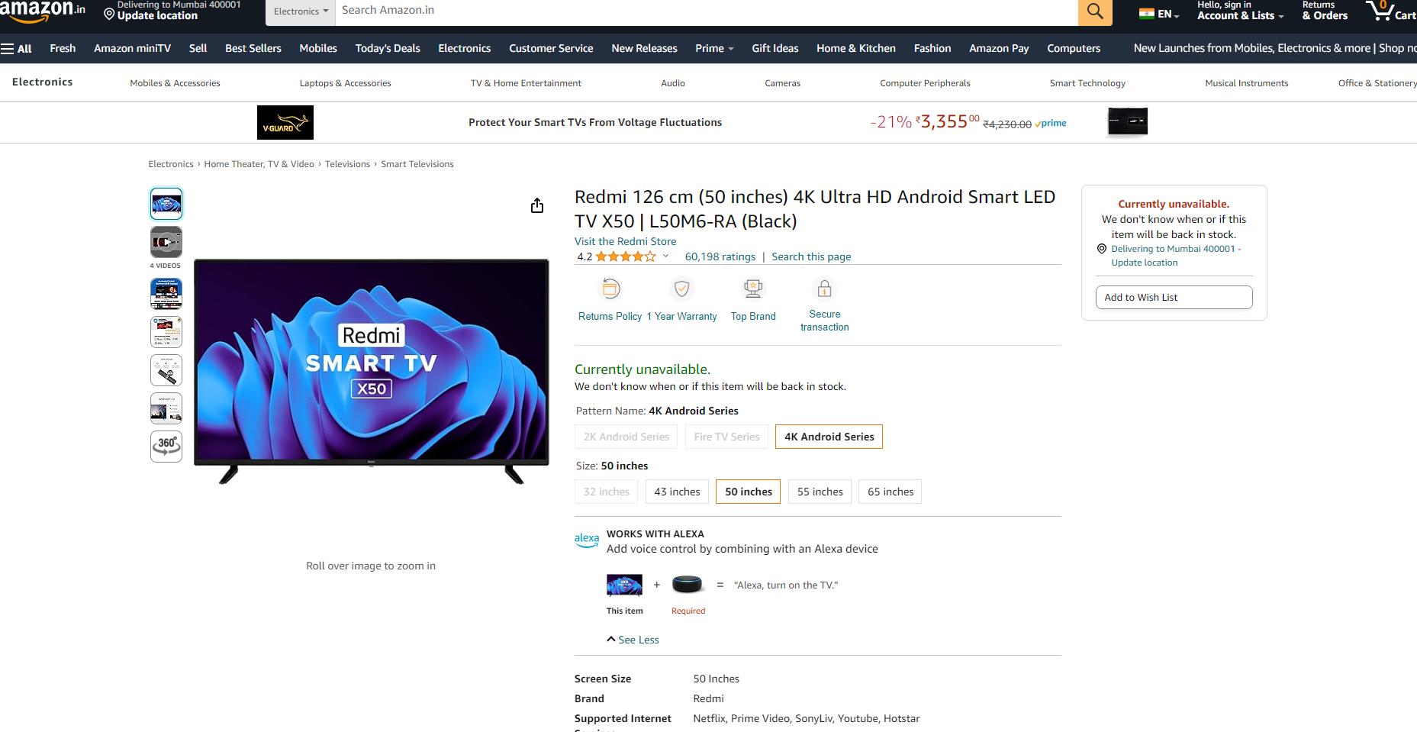
Observations
Smart Tvs:
- Total Number of items which are all Smart Televisions in our dataset are: 18.
- **"Product_id": B08Y55LPBF, product_name : Redmi 126 cm (50 inches) 4K Ultra HD Android S...** is the most popular Smart Tv in the dataset with the rating counts equal to 45238.0.
- Likewise, all the sentiment polarity scores are positive, which indicates that the reviews have a generally positive tone.Also, the subjectivity scores are also moderate, which implies that the reviews contain a mix of objective facts and subjective opinions.

Slide 14
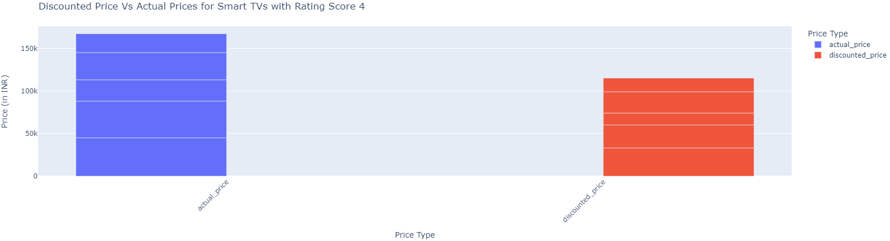
Data Visualizations
Fig5. Discounted Prices Vs Actual Prices
fig5.

Slide 15
Observations
Smart TVs:
- Also, the stacked bar graph showing a comparison between the actual prices and discounted prices of smart TVs with a rating score of 4, where one bar showing actual price of each product and another bar showing discounted price for each product suggests that the actual prices reach up to 150k INR while the discounted prices are consistently lower among the SmarT TVs int he dataset.

Slide 16
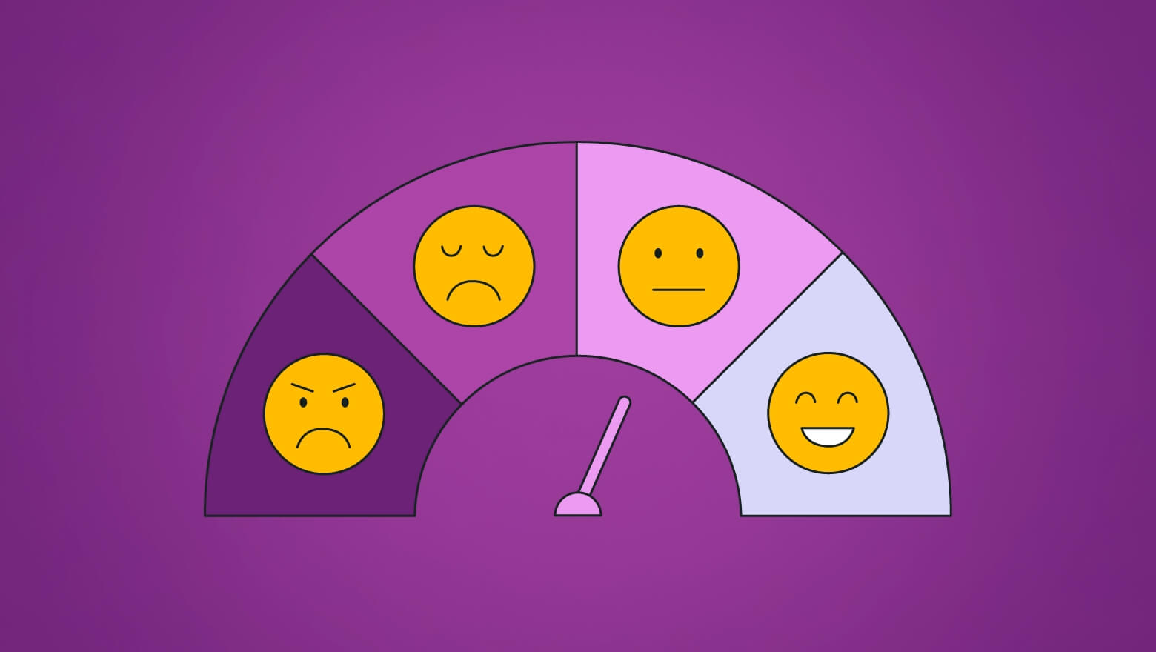
Functions used
Sentiment Analysis
Sentiment analysis is a technique that tries to understand if the words used in a text express positive, negative, or neutral feelings. Here, each 'sentiment' is a pair of numbers. These numbers are in the format (polarity, subjectivity)
**Sentiment Polarity:** The polarity score ranges from -1 (most negative) to 1 (most optimistic).
**Sentiment Subjectivity:**
The subjectivity score ranges from 0 (most objective) to 1 (most subjective). Higher scores indicate a more opinion or subjective text, while lower scores suggest factual or objective text.
New Python library used: TextBlob.
fig 5.

Slide 17
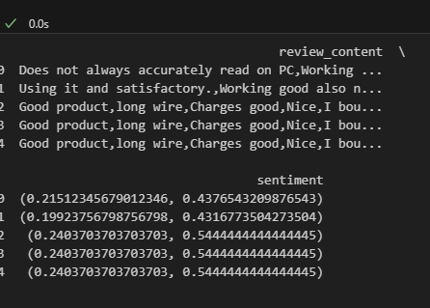
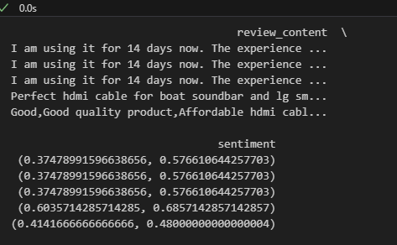
Computer USBs
New Python library used: TextBlob.
Sentiment Analysis
Tv HDMIs
fig 5.

Slide 18
Observations
- Within the data frame made out of the five Most Popular Smart TVs, we found the correlation coefficient between 'rating_count' and 'discounted_price' is approximately 0.054, which indicates a very weak positive linear relationship between the number of ratings a product has received and its discounted price within the dataset. This suggests that there is barely any linear correlation between how many times a product has been rated and its discounted price and vice versa.

Slide 19
Observations and Limitations
- The weak correlation could suggest that the price is influenced more by other factors such as brand value, features, market demand, and competition rather than by the number of ratings.
- Consumers might not necessarily be looking at the number of ratings when considering the price they're willing to pay for a Smart TV. The quality of reviews, brand reputation, or specific features might more influence them.
- The observation is based on a dataset of the five most popular Smart TVs, which might not be representative of all Smart TVs or electronic devices. A broader dataset might yield different results.
- It might be useful to look at other variables that could influence the price, such as average review score, brand, screen size, features, etc., to see if they have a stronger correlation with price.

Slide 20

Questions?

Slide 21

Thank you!
Stuti Poudel​
XXX-XXX-XXXX
Stuti.poudel@outlook.com

